Slide 1
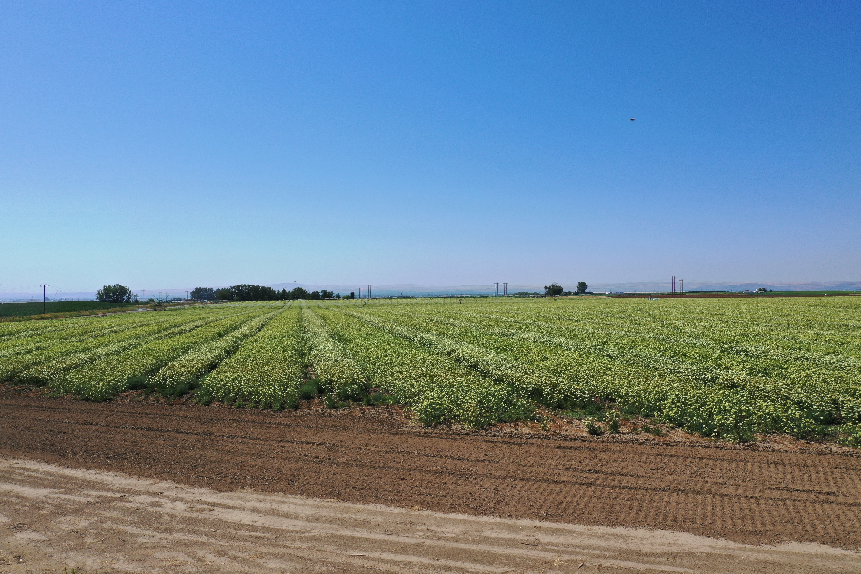
The impact of supplemental feeding on honey bee foraging habits in carrot seed.
Riley Reed & Brandon Hopkins

Slide 2
The production of hybrid vegetable seed relies on isolation between fields.
(Wohleb, 2020)
Notes:
Hybrid vegetable seed production relies on isolation between fields
Also requires pollination, generally by honey bees
To preserve isolation, growers in the Columbia basin in Washington currently work together to plan out who will grow what where, maintaining at least 2 miles between fields of different varieties of the same crop

Slide 3
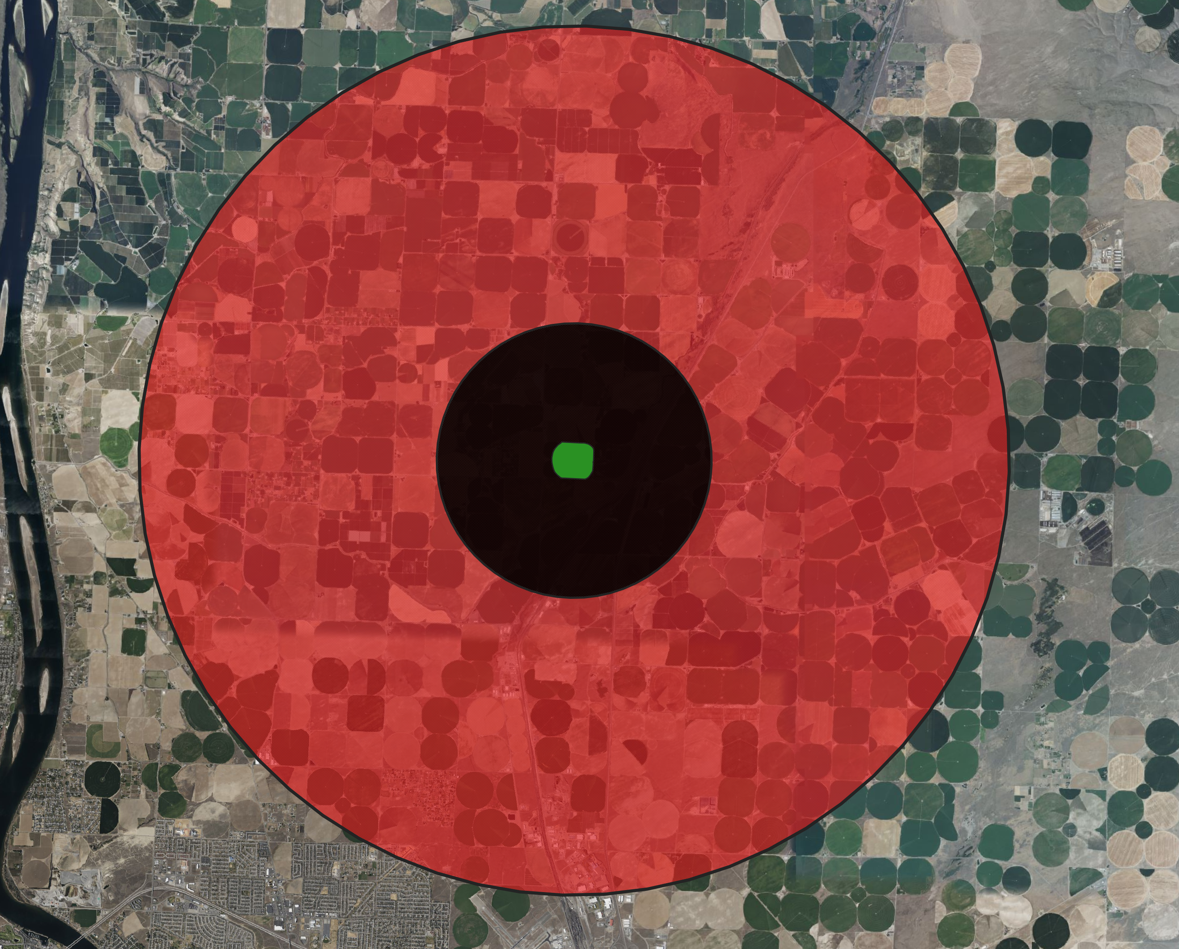
The foraging distance of honey bees depends on forage availability and quality.
(Visschner and Seeley 1982; Beekman and Ratnieks 2000)
Notes:
Bees will generally stay within 2-3 km of the hive under natural conditions
But when forage is scarce they will fly up to 9.5km in search of food

Slide 4
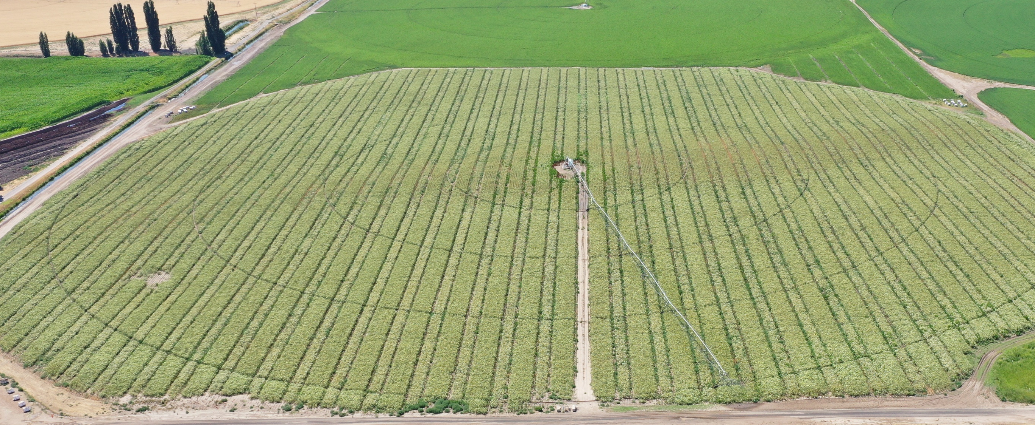
The poor conditions of a hybrid seed field forces bees to search for alternative forage.
Gaffney et al. 2011; Hendriksma and Shafir 2016; Zarchin et al. 2017
Notes:
Bees are polylectic
Vegetable seed pollination is a monoculture
Less than half of each hybrid field produces pollen (Gaffney et al. 2011)

Slide 5
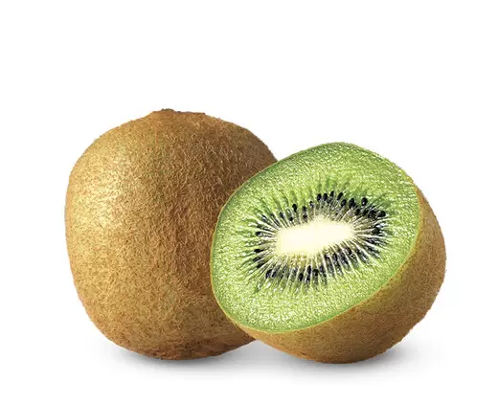
Kiwi growers in New Zealand also struggled to keeps bees on their crop.
Photo courtesy of Aldi

Slide 6
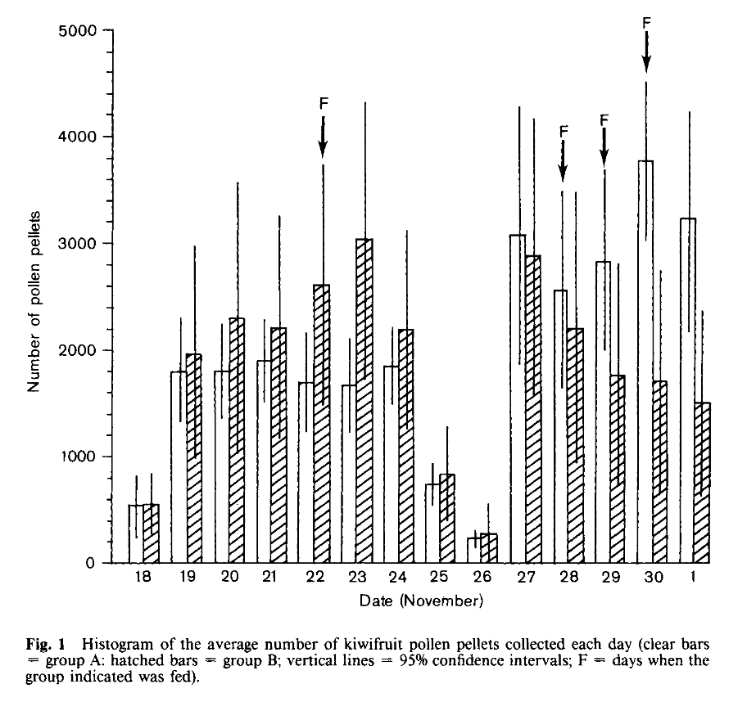
Feeding sugar syrup increase the collection of kiwi pollen.
Treatment groups switched
Goodwin, 1986

Slide 7
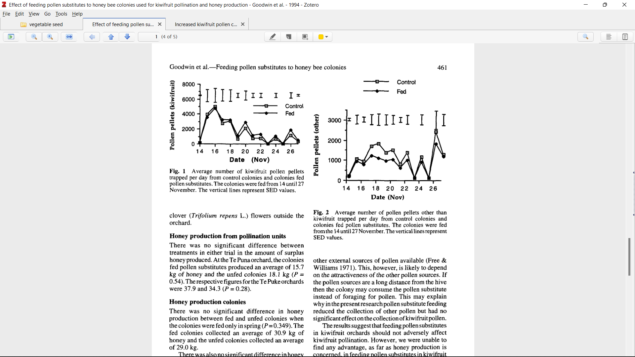
Feeding pollen substitute decreased the collection of other pollen other plants.
Goodwin et al., 1994

Slide 8
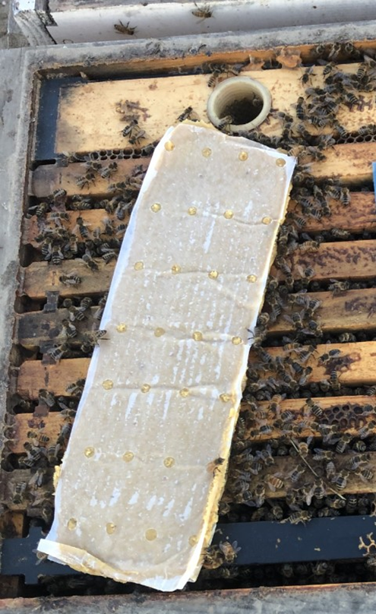
Hypothesis: Providing supplemental in-hive feeding will remove their need to forage at longer distances.

Slide 9
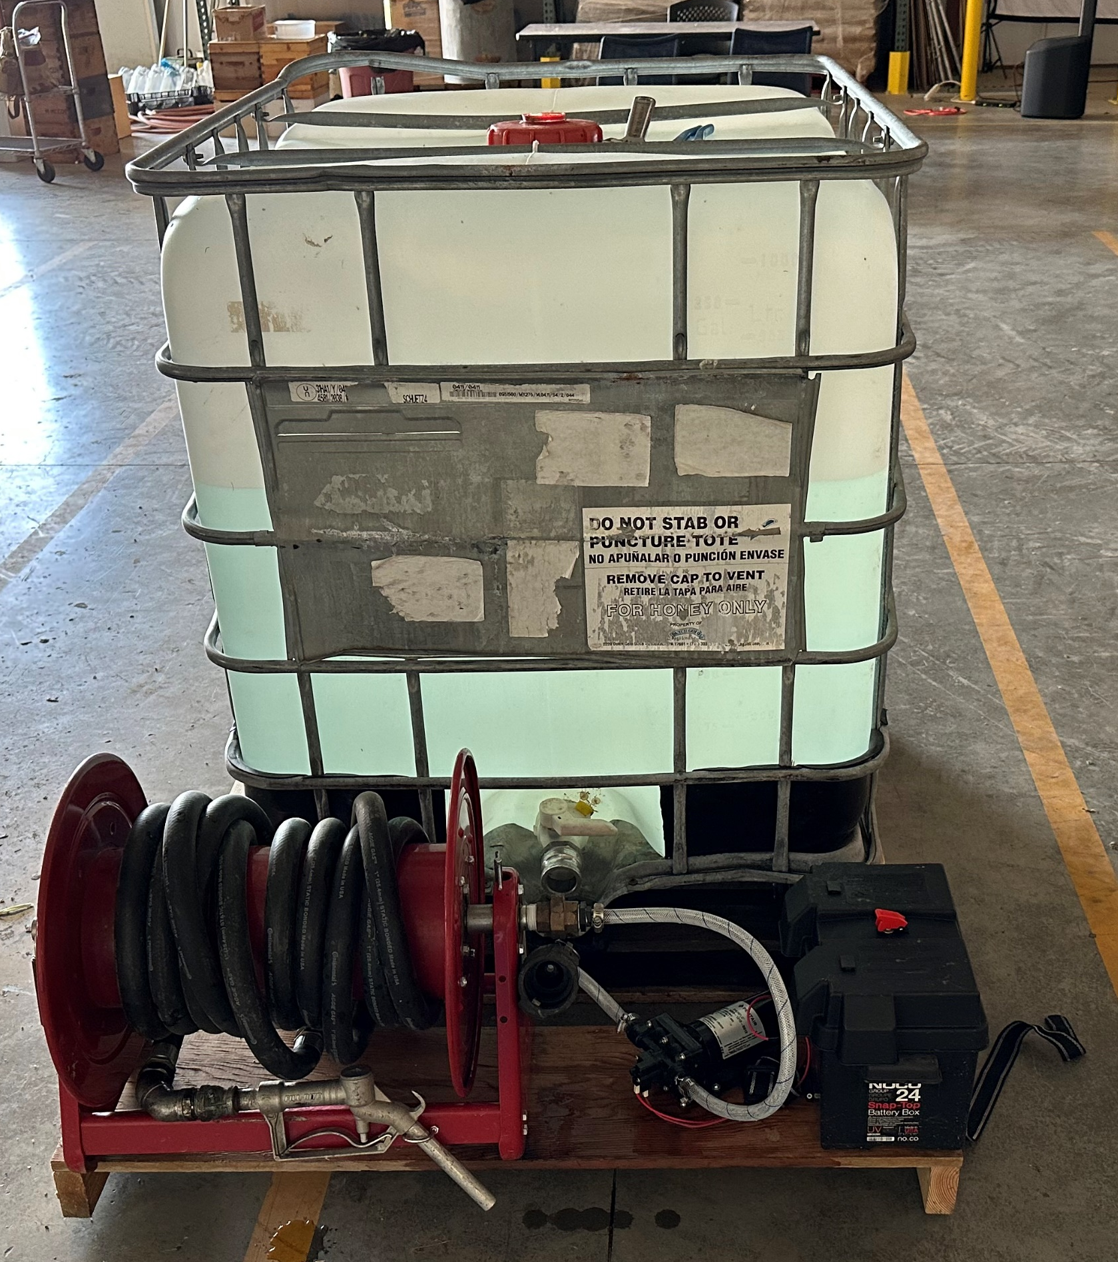
Colonies were fed sugar syrup and pollen substitute each week during carrot pollination.

Slide 10
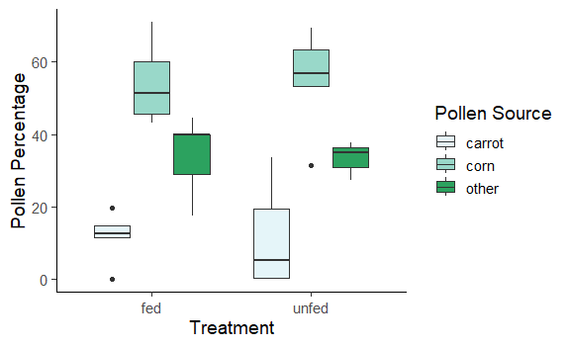
Feeding during carrot pollination did not significantly impact pollen diversity.
b
b
b
Pollen Source
ab
Carrot
Corn
Other
a
a

Slide 11
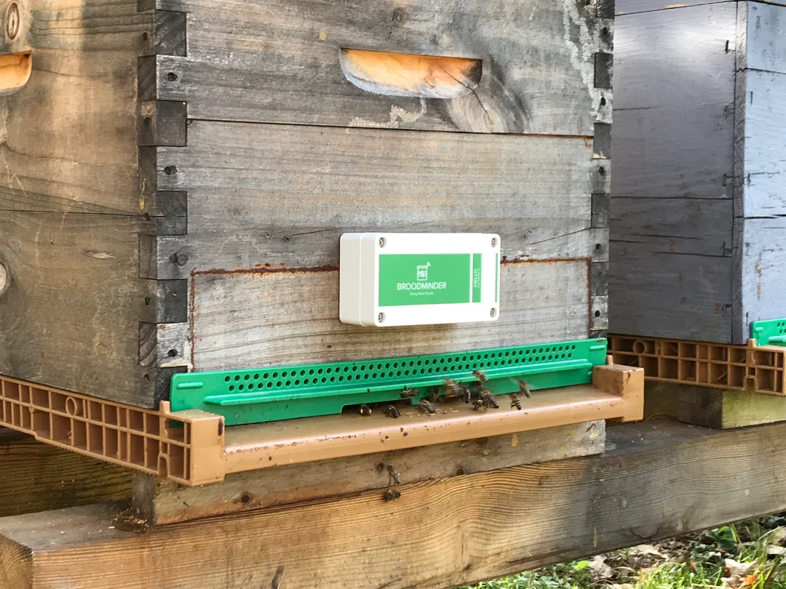
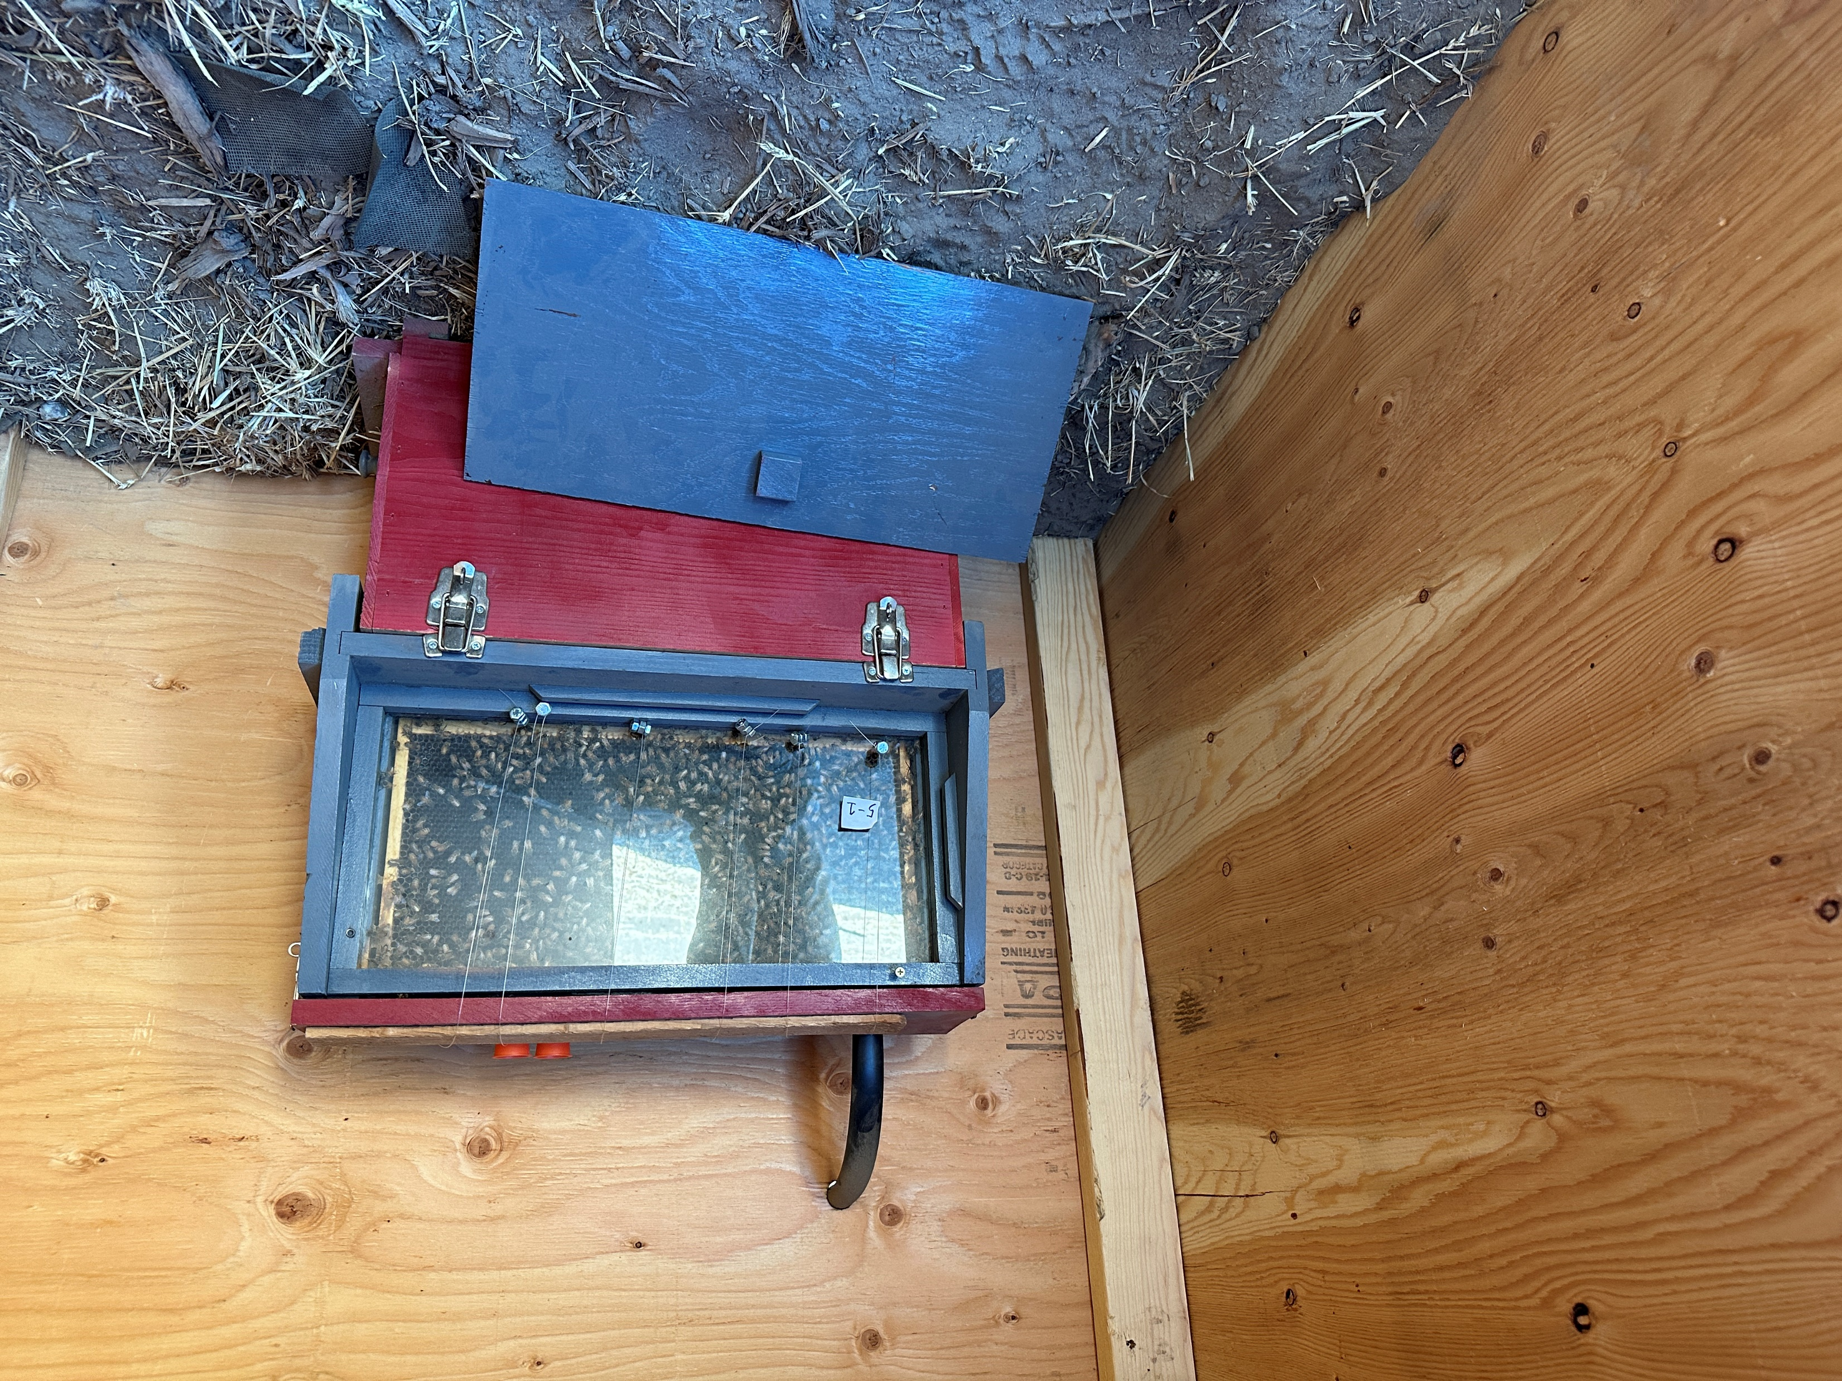
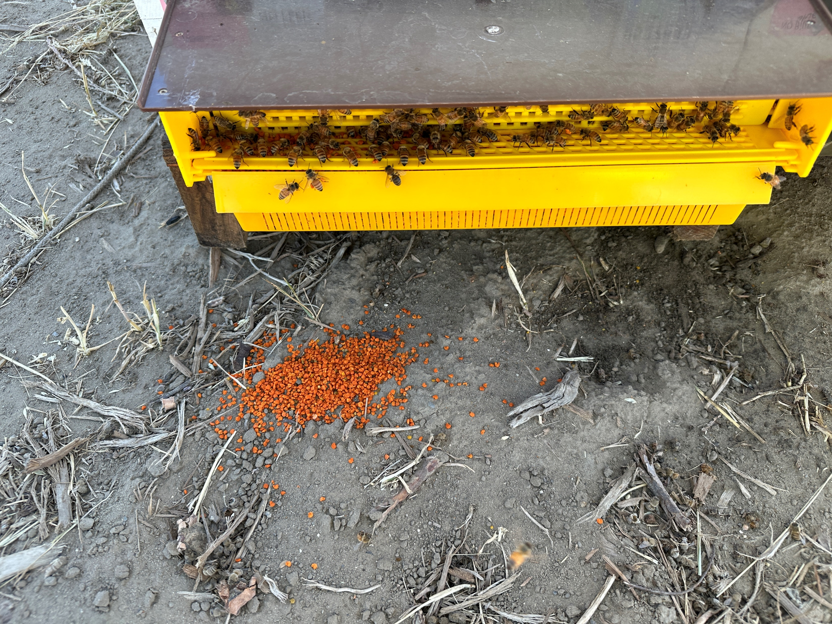
In 2024, feeding began during almond pollination.

Slide 12
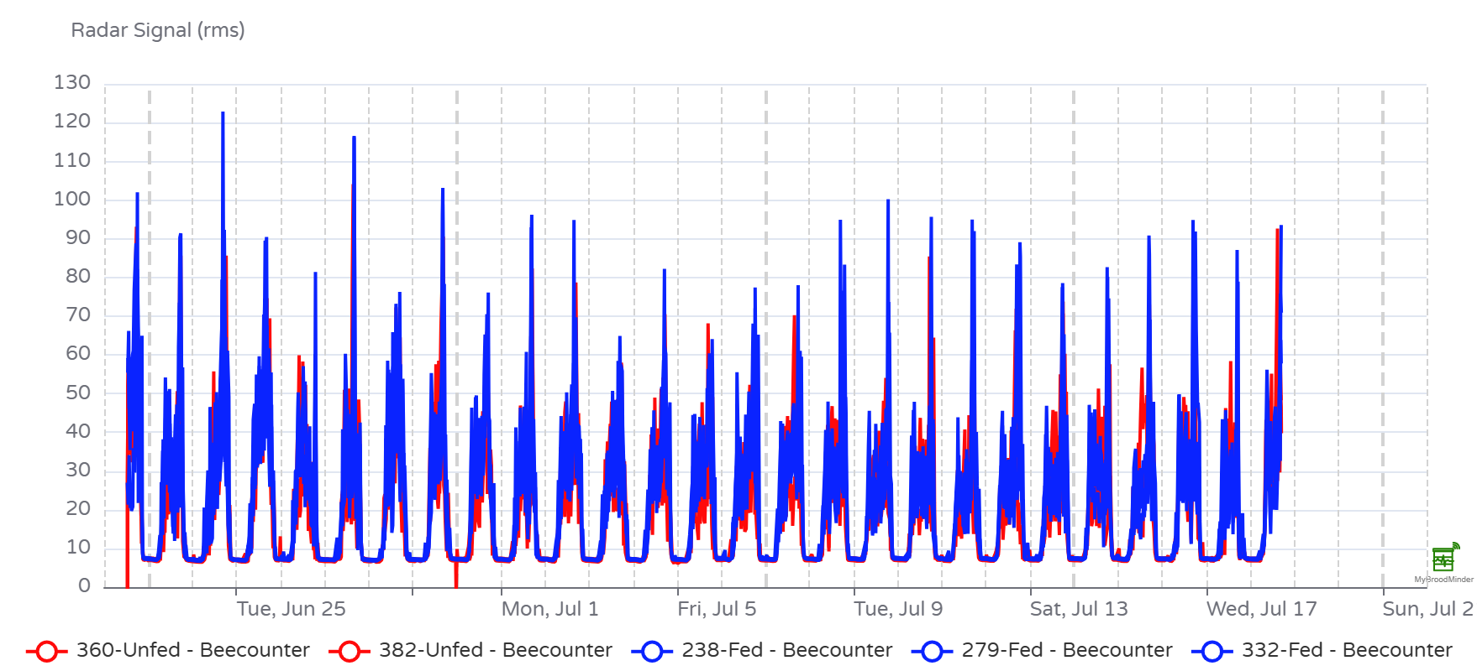
Feeding had no significant impact on activity.
Fed
Unfed

Slide 13
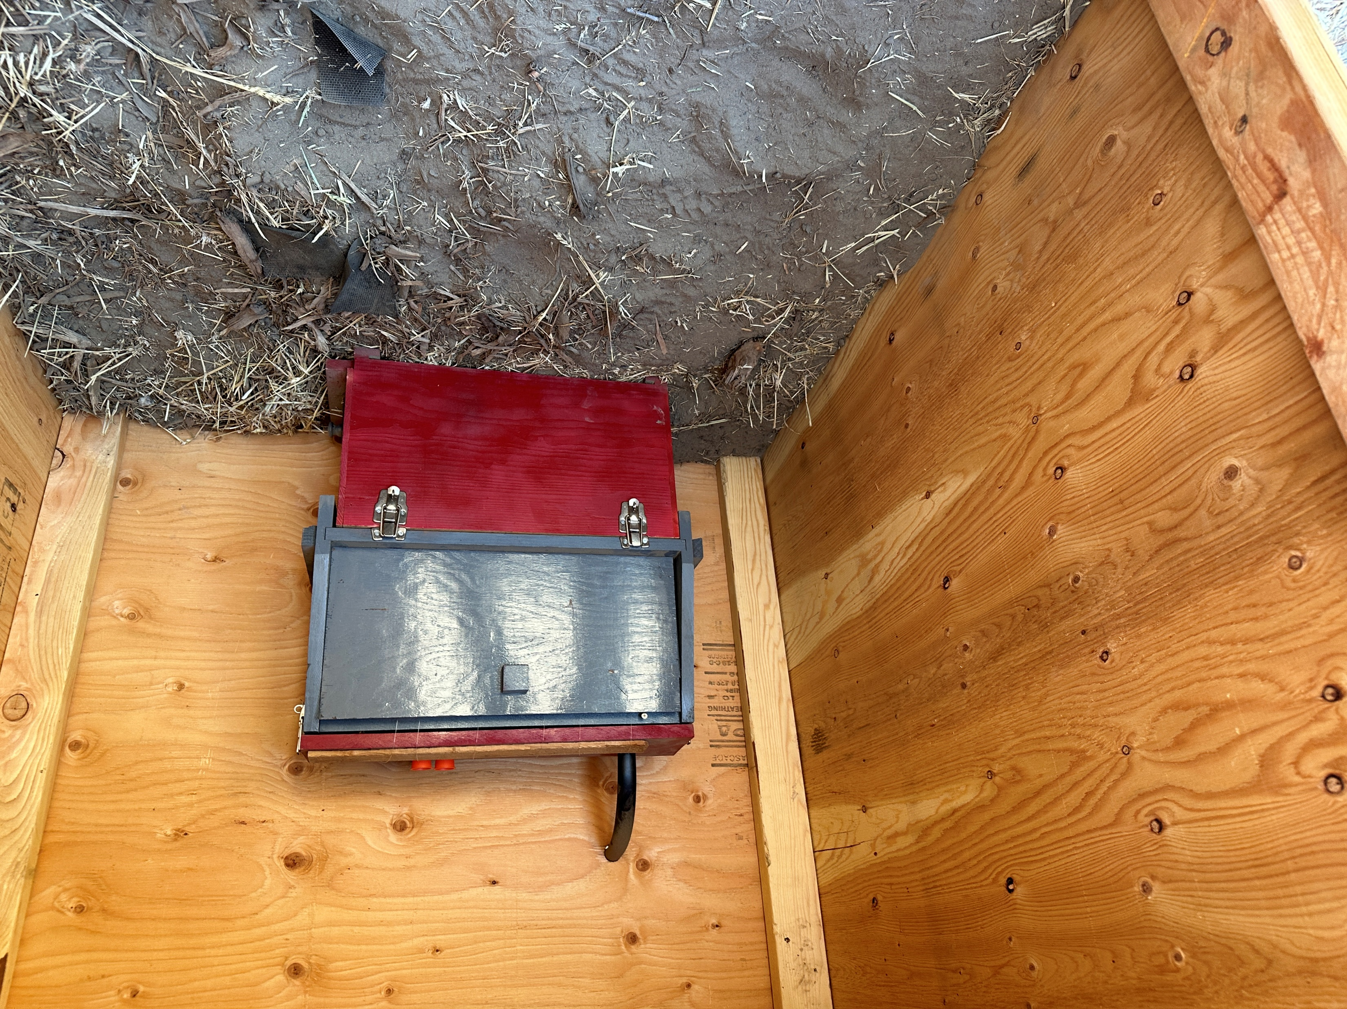
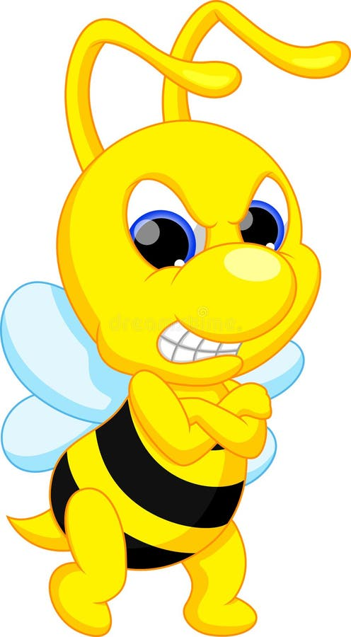
The design of our observation hives prevented us from recording waggle dances

Slide 14
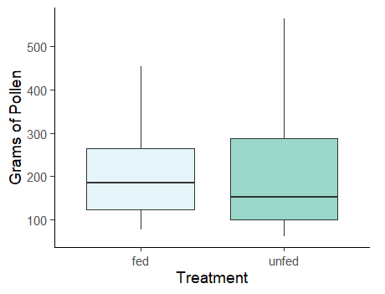
Feeding had no significant effect on the amount of pollen collected by colonies.

Slide 15
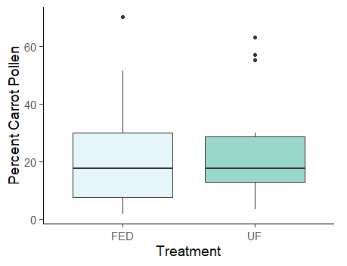
Feeding had no significant impact on the diversity of pollen collected by foragers.
Notes:
At the beginning of pollination, the non carrot pollen was largely asparagus, by the end of pollination it was largely corn
Nearest asparagus field was approximately 4.5 miles from the field

Slide 16

In-hive feeding did not decrease foraging distance, but increasing food stores might.
(Chabert et al., 2024; Seeley 1986, Seeley 1989)

Slide 17
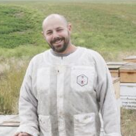
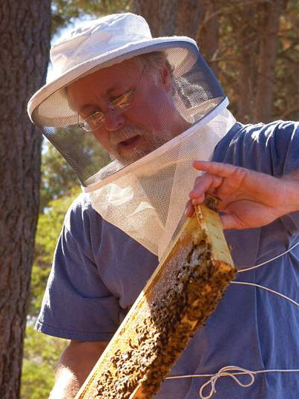
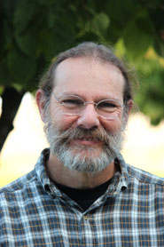
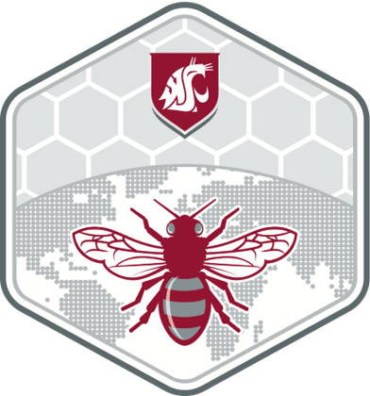
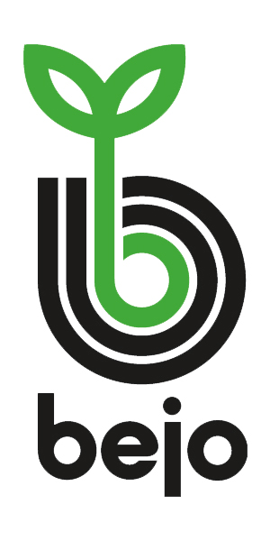
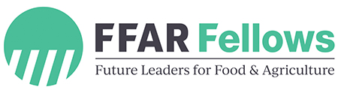
Thanks

Slide 18
References
Chabert, S., Morison, N., Buffière, M.-J., Guilbaud, L., Pleindoux, C., de Premorel, G., Royer, P., Harruis, M., & Vaissière, B. E. (2024). Supplementing honey bee (Hymenoptera: Apidae) colonies with pollen increases their pollinating activity on nectariferous crops with anthers isolated from stigmas. Journal of Economic Entomology, 117(1), 43–57. https://doi.org/10.1093/jee/toad222
Couvillon, M. J., Riddell Pearce, F. C., Harris-Jones, E. L., Kuepfer, A. M., Mackenzie-Smith, S. J., Rozario, L. A., Schürch, R., & Ratnieks, F. L. W. (2012). Intra-dance variation among waggle runs and the design of efficient protocols for honey bee dance decoding. Biology Open, 1(5), Article 5. https://doi.org/10.1242/bio.20121099
Gaffney, A., Allen, G. R., & Brown, P. H. (2011). Insect visitation to flowering hybrid carrot seed crops. New Zealand Journal of Crop and Horticultural Science, 39(2), Article 2. https://doi.org/10.1080/01140671.2010.526619
Goodwin, R. M. (1986). Increased kiwifruit pollen collection after feeding sugar syrup to honey bees within their hive. New Zealand Journal of Experimental Agriculture, 14(1), Article 1. https://doi.org/10.1080/03015521.1986.10426125
Goodwin, R. M., Houten, A. T., & Perry, J. H. (1994). Effect of feeding pollen substitutes to honey bee colonies used for kiwifruit pollination and honey production. New Zealand Journal of Crop and Horticultural Science, 22(4), Article 4. https://doi.org/10.1080/01140671.1994.9513858
Hendriksma, H. P., & Shafir, S. (2016). Honey bee foragers balance colony nutritional deficiencies. Behavioral Ecology and Sociobiology, 70(4), Article 4. https://doi.org/10.1007/s00265-016-2067-5
Marden, J. H., & Waddington, K. D. (1981). Floral choices by honeybees in relation to the relative distances to flowers. Physiological Entomology, 6(4), Article 4. https://doi.org/10.1111/j.1365-3032.1981.tb00658.x
Schürch, R., Zwirner, K., Yambrick, B. J., Pirault, T., Wilson, J. M., & Couvillon, M. J. (2019). Dismantling Babel: Creation of a universal calibration for honey bee waggle dance decoding. Animal Behaviour, 150, 139–145. https://doi.org/10.1016/j.anbehav.2019.01.016
Seeley, T. D. (1986). Social foraging by honeybees: How colonies allocate foragers among patches of flowers. Behavioral Ecology and Sociobiology, 19(5), 343–354. https://doi.org/10.1007/BF00295707
Seeley, T. D. (1989). Social foraging in honey bees: How nectar foragers assess their colony’s nutritional status. Behavioral Ecology and Sociobiology, 24(3), 181–199. https://doi.org/10.1007/BF00292101
Visscher, P. K., & Seeley, T. D. (1982). Foraging strategy of honeybee colonies in a temperate deciduous forest. Ecology (Durham), 63(6), Article 6. https://doi.org/10.2307/1940121
Wohleb, C. (2020, January 13). Isolating Seed Fields in the Columbia Basin of Washington. Columbia Basin Seed Field Representatives Association. https://s3.wp.wsu.edu/uploads/sites/2082/2021/03/2021-CBSFRA-Seed-Field-Isolation-Packet.pdf
Zarchin, S., Dag, A., Salomon, M., Hendriksma, H. P., & Shafir, S. (2017). Honey bees dance faster for pollen that complements colony essential fatty acid deficiency. Behavioral Ecology and Sociobiology, 71(12), Article 12. https://doi.org/10.1007/s00265-017-2394-1

Slide 19
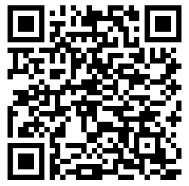
Questions?
Riley.reed@wsu.edu
www.linkedin.com/in/rileymreed
Feedback survey →
https://bugmanriley.com/

